Slide 1
TDD with Python
Chapter 04
CIDM6330

Slide 2
As tests reveal the app, the app will evolve
Appropriate questions at this point:
Why all these tests?
Why are they all so low-level?
Why are we being so pedantic?
This is too slow, I wanna write “real” apps
I am reminded of “Daniel-san” from the Karate Kid
He didn’t want to “wax on and wax off”
We are human, we are flawed
Airline pilots have checklists, so they don’t miss something important
You have your TDD to help you with managing complexity

Slide 3
Onward: User Input
So, how do we test user input in a web app?
Selenium
Don’t forget
Run test
It breaks
Code to fix
Run test
Don’t test constants
They are self-evident
Test dynamic data

Slide 4
Refactoring
What happens when you realize, even when your tests pass, that something’s not quite right?
Your understanding has changed
Your skills have changed
What the end-user/client wants has changed
Django uses templates to create views
Django lets us test client interactions
Django test client

Slide 5
More refactoring
We need to develop refactoring as a tacit instinct
Refactoring and TDD encourages mindful small steps
“Don’t get ahead of yourself”

Slide 6
TDD: Let’s Take Stock Again
The key ingredients have been:
Functional Tests
Unit Tests
The Unit-Test/Code cycle
Refactoring

Slide 7
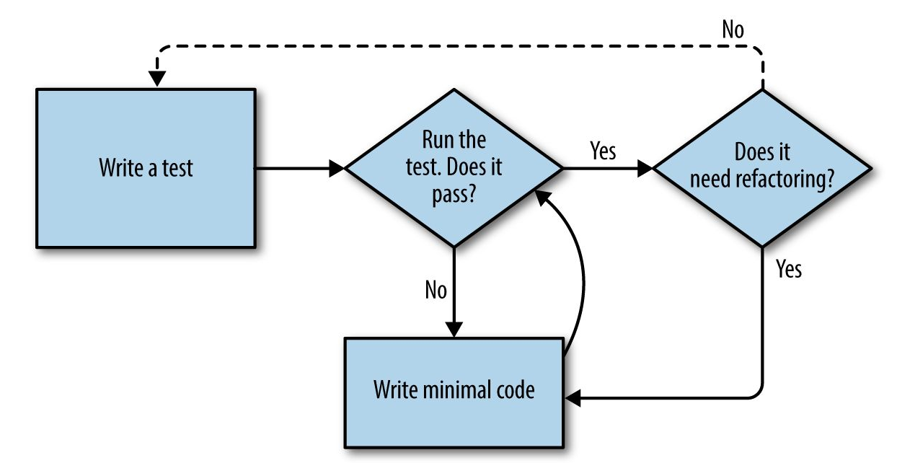
The TDD Process

Slide 8
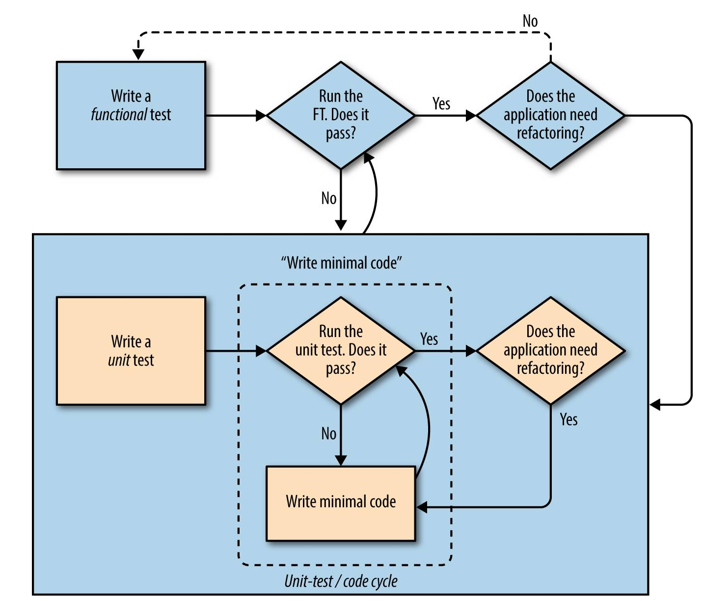
The TDD Process – Big Picture

Slide 9
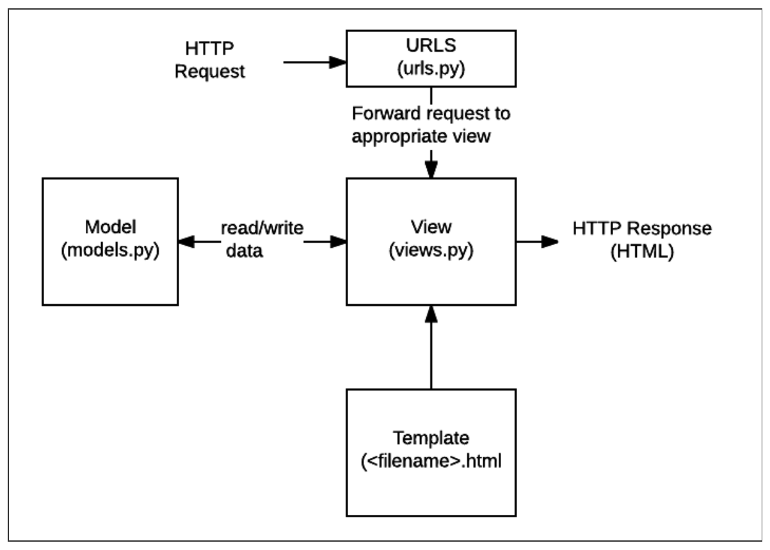
Django Process Big Picture

